Slide 1
A+ TEAM – GO Final project
HARSH
MOHAMMED ABDUL AKRAM KHAN
MOHAMAD MAHDI ZIAEE
MUKHASIR SHAH SYED

Slide 2
DEMO
http://gotraining-1271.appspot.com/

Slide 3
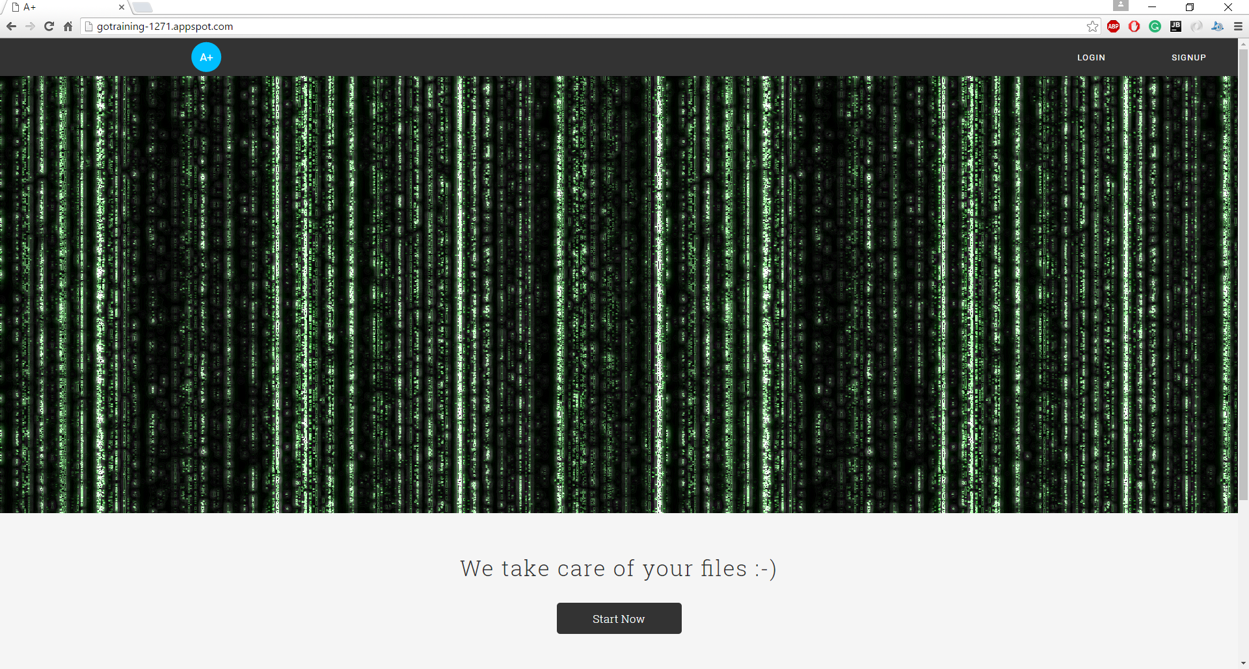
HOME PAGE

Slide 4
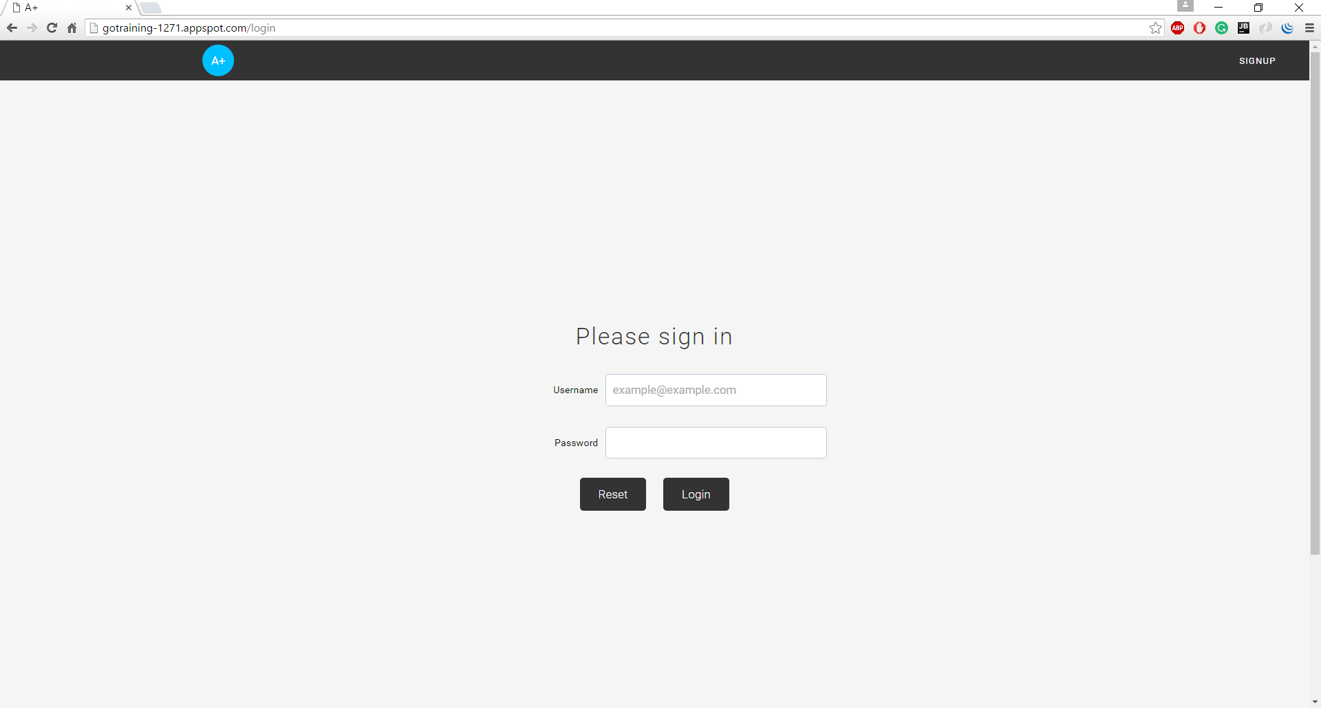
Click on start now button will go login page

Slide 5
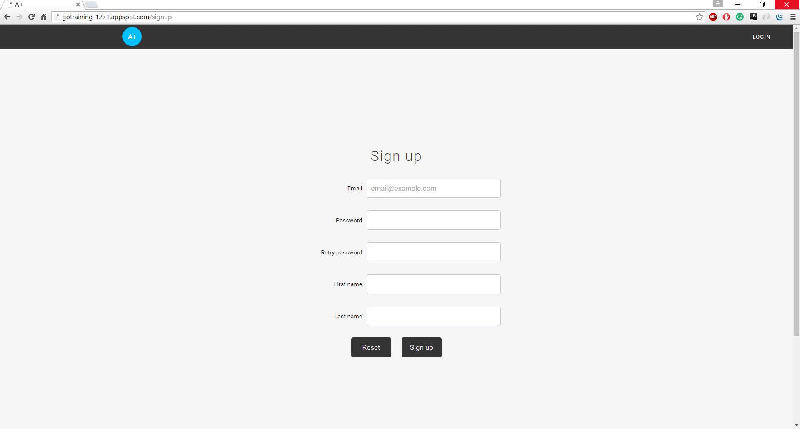
SIGNUP
Each field has
their validations

Slide 6
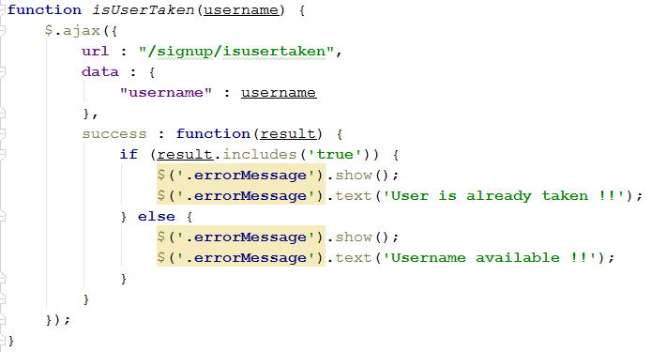
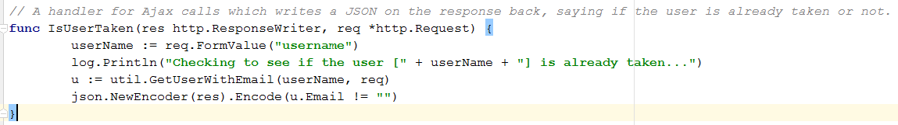
AJAX CALL Client & Server

Slide 7
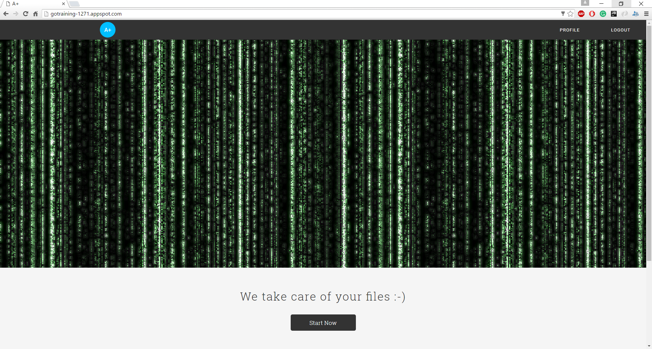
AFTER LOGIN – PAGE DISPLAYED

Slide 8
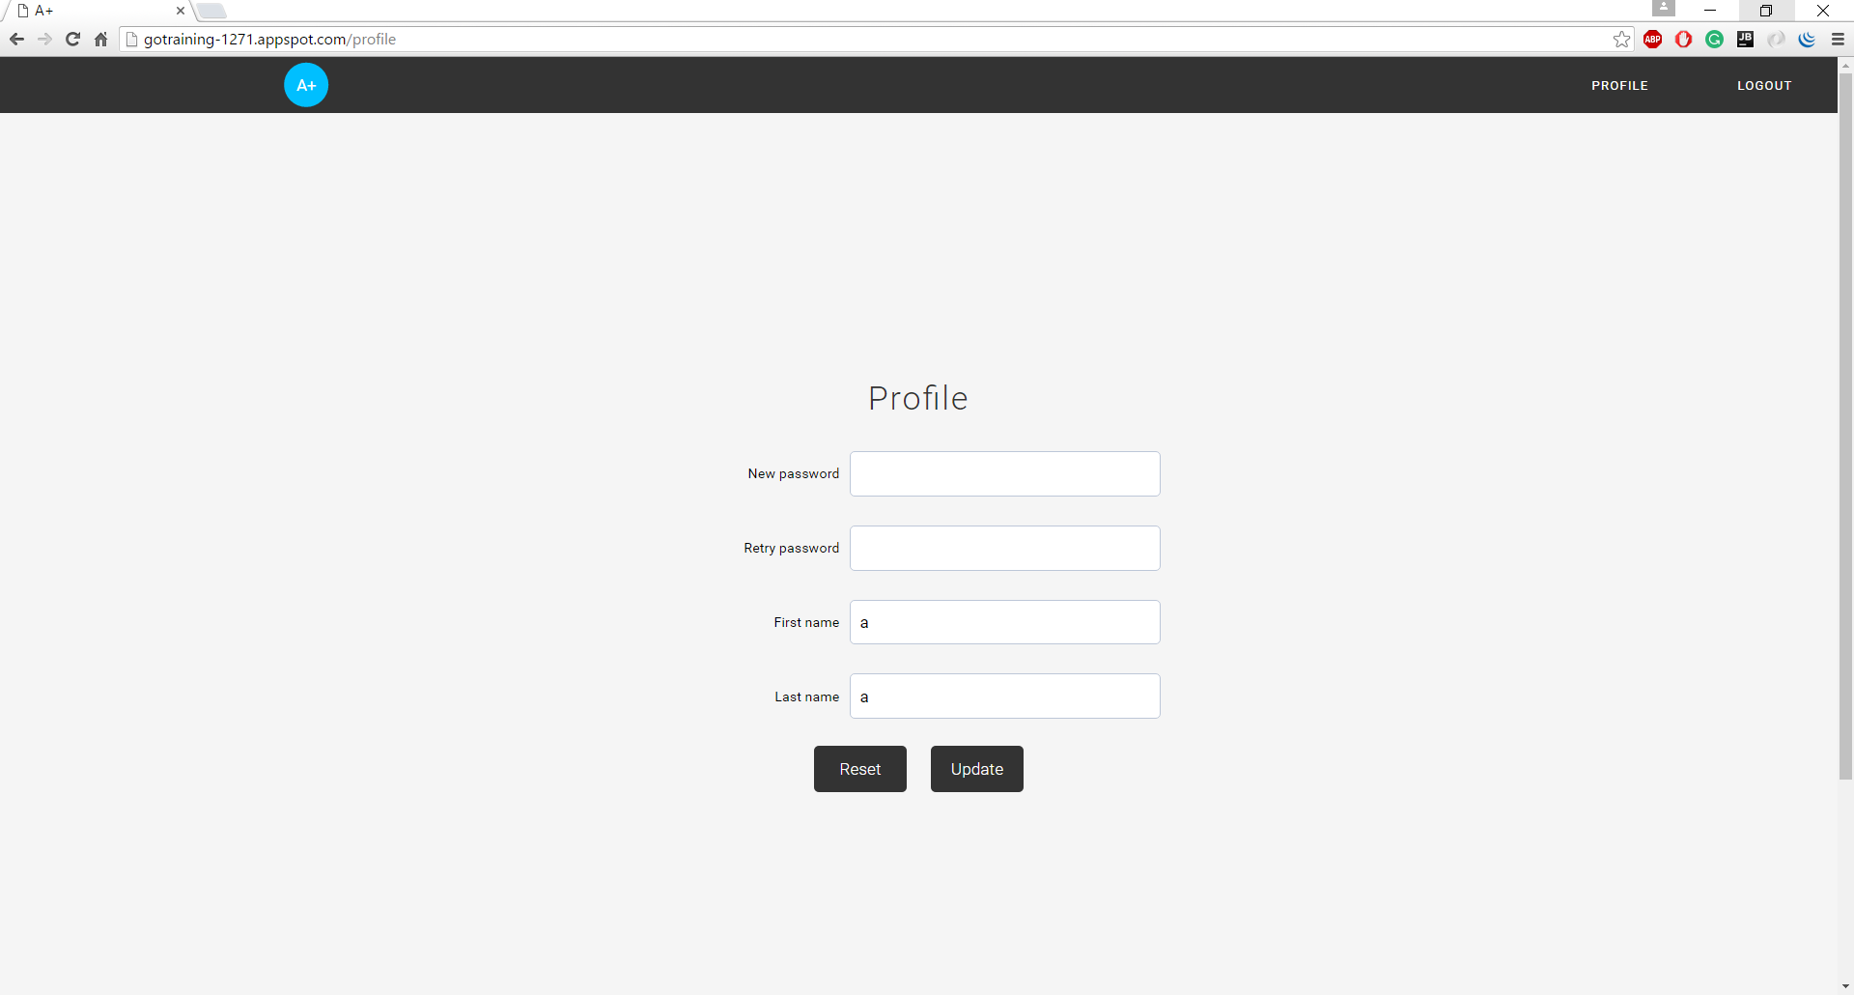
AFTER LOGIN – START NOW WILL GO TO PROFILE
Data retrieve from memcache, if not present then from datastore.

Slide 9
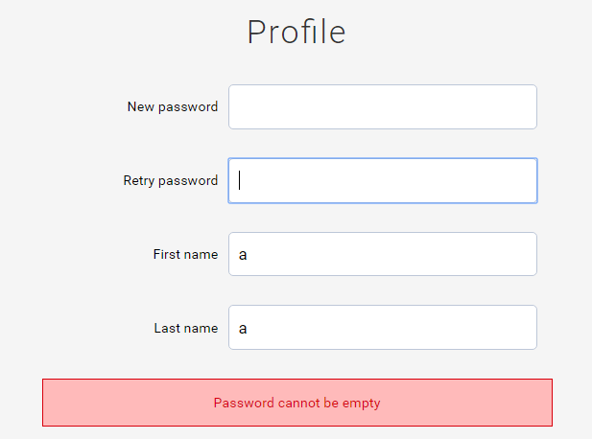
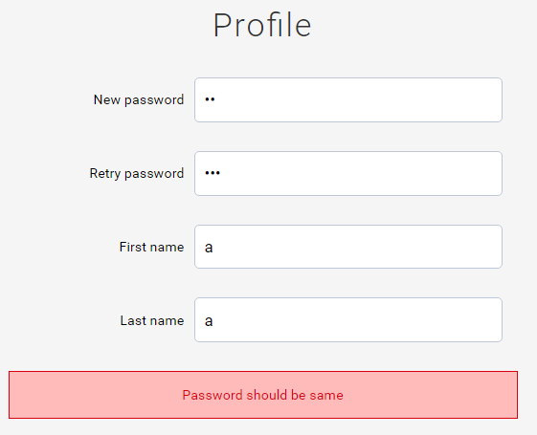
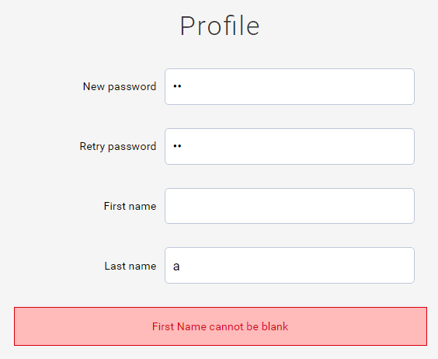
VALDATIONS IN PROFILE PAGE

Slide 10
LOGOUT
This delete the existing cookies and the user will have to use username and password to access the content.
We have validations on Login, SignUP and Profile Pages.

Slide 11

THANK YOU

Slide 12

QUESTIONS

